Slide 1
MATERIAL STOCK REPORT
GROUP 10 CASE STUDY:
1. 280466 – CHARITH VARMA VUYYURI
2. 280473 – RAJU MADIPELLI
3. 280415 – DHRUVI KHASIA
Under the Guidance of
Upender Reddy Nallori

Slide 2
PROJECT REQUIREMENTS
Generate an OOALV Report by passing 3 Select-Options:
Creation Date (ESRDA) - Mandatory
Plant (WERKS)
Storage Location (LGORT)
Data is retrieved through For All Entries.
Print Adobe Form when user clicks print button in OOALV Report.
CDS VIEW.

Slide 3
CONTENTS
SELECTION SCREEN VALIDATIONS
OOALV REPORT
ADOBE FORM FOR RELEVANT DATA
ADOBE FORM FOR ALL STORAGE LOCATIONS
CDS VIEW

Slide 4
TABLES USED
We have used 3’Z-Transparent tables in our project:
ZMATERIAL – Contains Material Information
ZPLANT_STOR – Plant and Storage Location
ZMATERIAL_STOCK - Material Stock Details

Slide 5
Package : ZG10_PROJ_PACK
OOALV Report : ZG10_FORALL_OOALV
ADOBE FORM1 : ZG10_ALL_ADOBE
ADOBE FORM1 Driver Program : ZG10_ALL_ADOBE_INC (Include Program)
ADOBE FORM2 : ZG10_AF_REL_DATA
ADOBE FORM2 Driver Program: ZG10_ADOBE_FORM (Include Program)
CDS VIEW : ZG10_CDS_VIEW
CDS VIEW Driver Program : ZG10_CDS_REPORT

Slide 6
SELECTION SCREEN
Consists of 3 Select-Options:
Created On – Mandatory
Plant – Optional
Storage Location – Optional

Slide 7
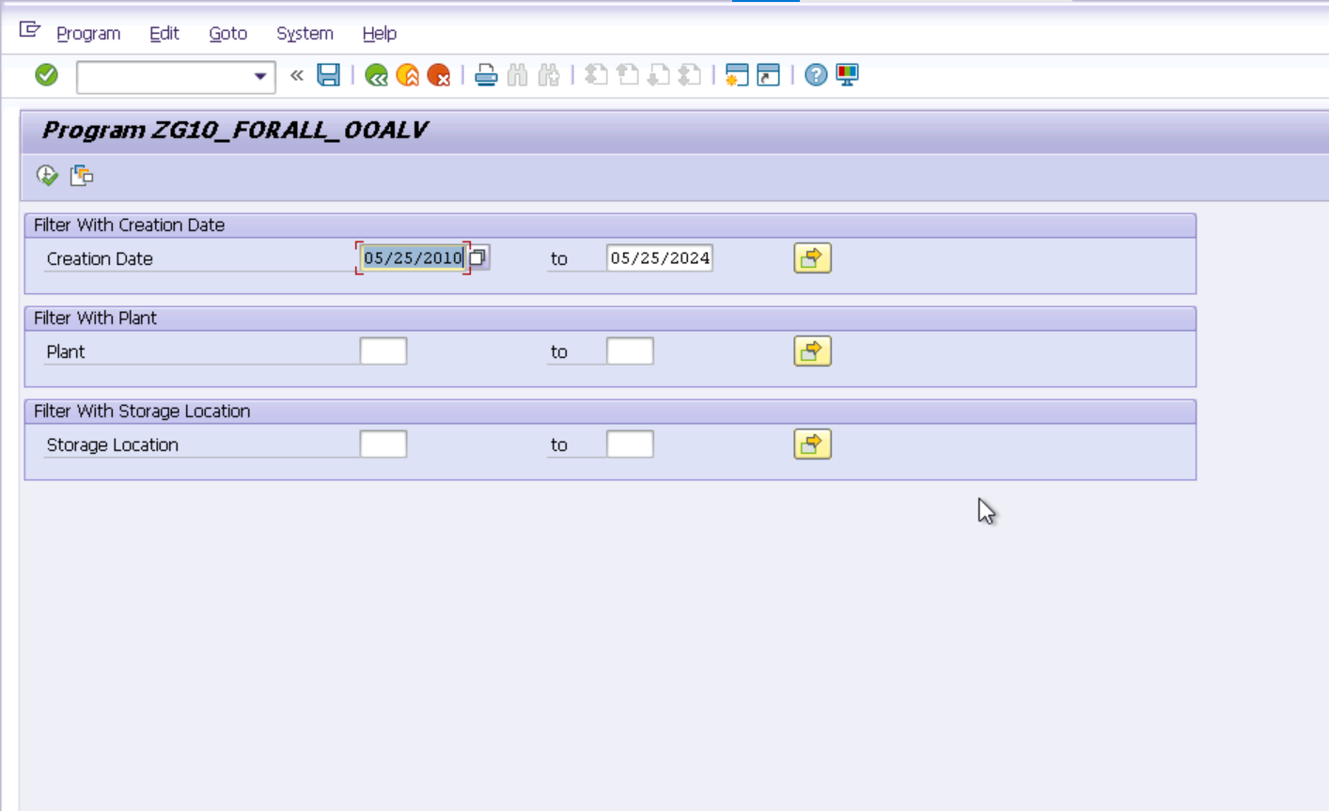
SELECTION SCREEN

Slide 8
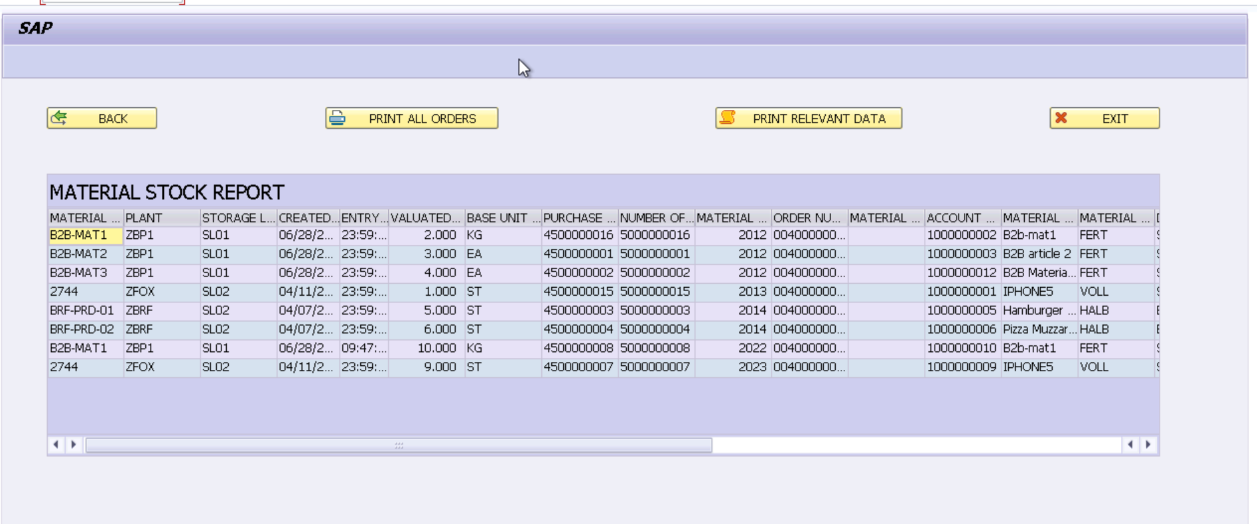
OOPS ALV

Slide 9
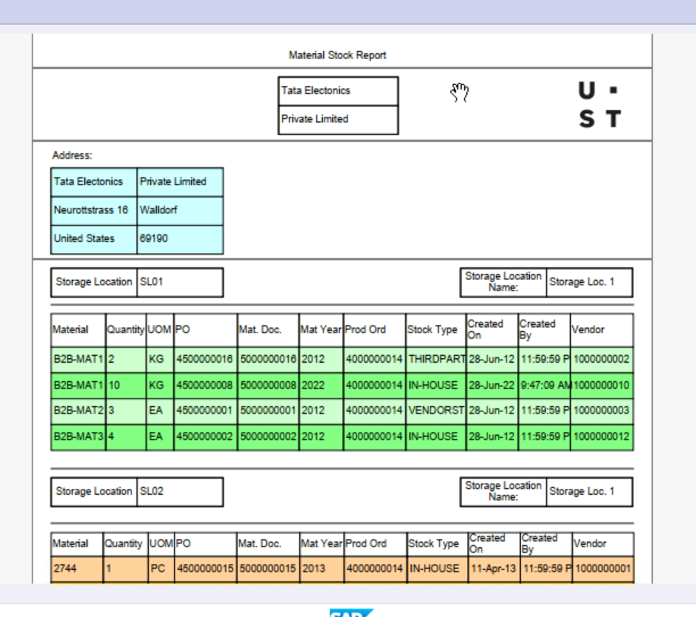
ADOBE FORM for all Materials in Storage Locations

Slide 10
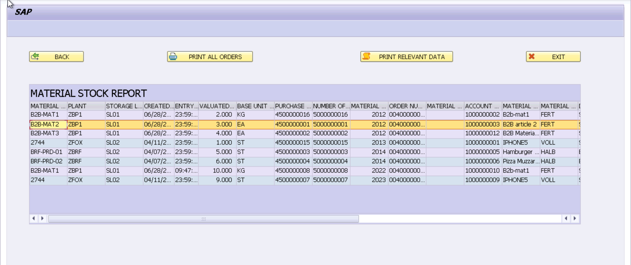
OOPS ALV

Slide 11
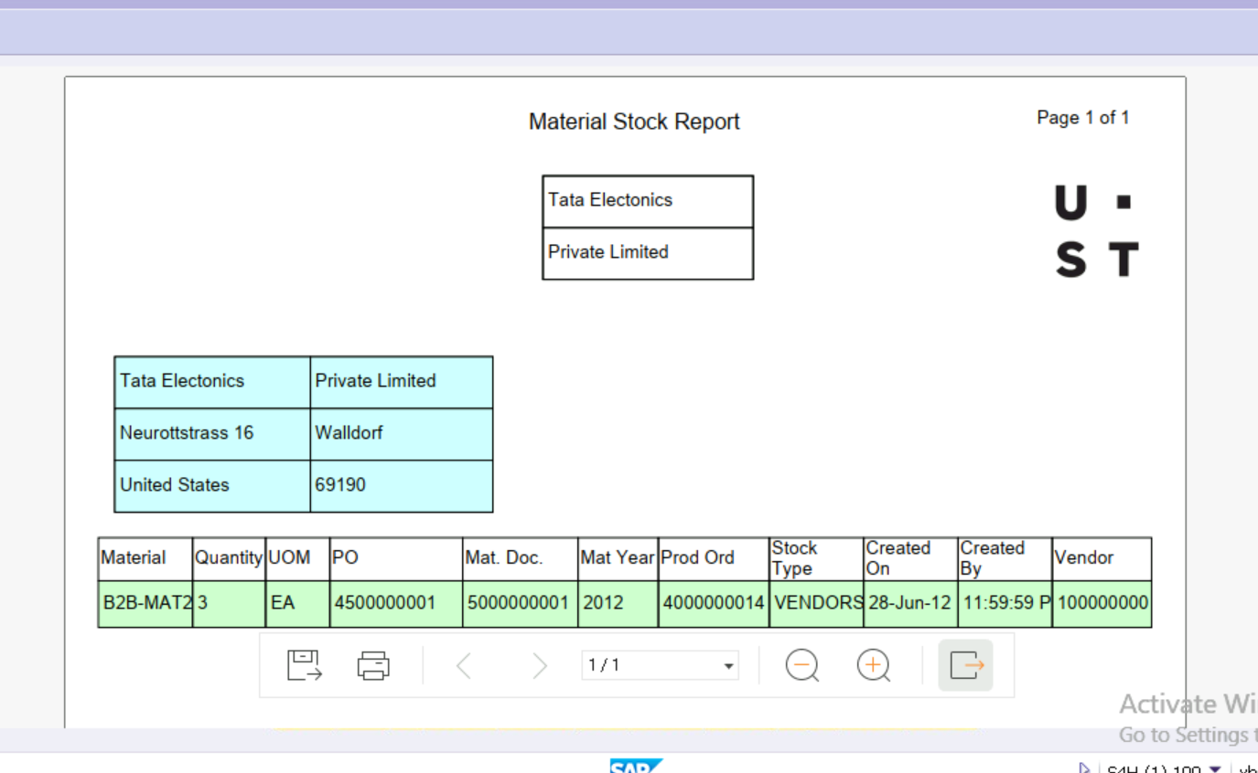
ADOBE FORM for Relevant Material Data

Slide 12
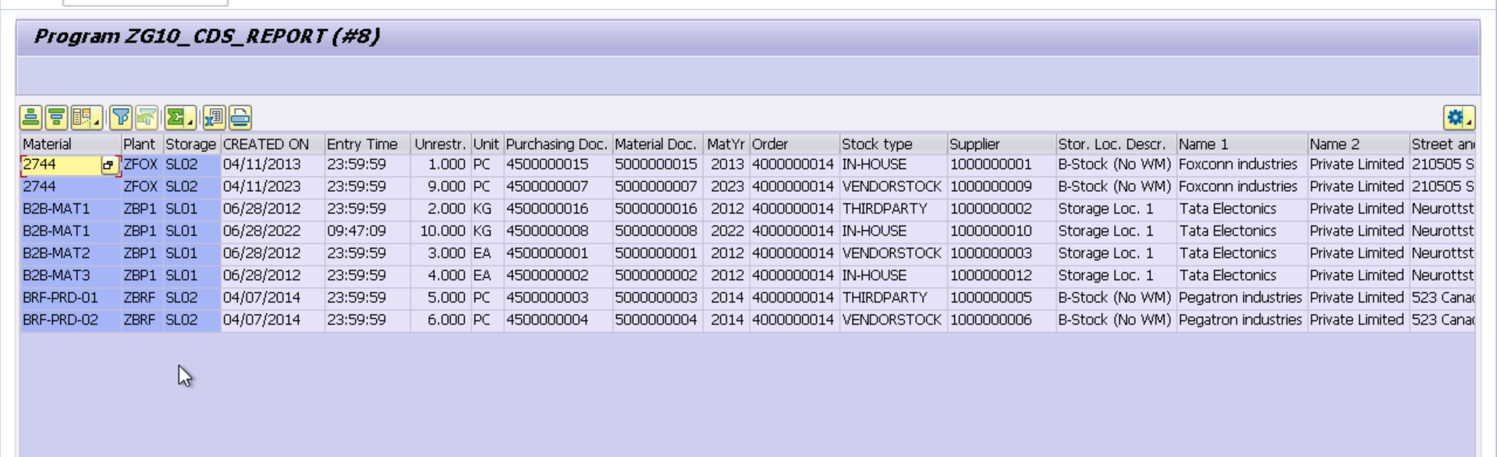
CDS VIEW

Slide 13
Special thanks to Upender Reddy Nallori and Ramesh Kalavakota for their guidance throughout this case study.

Slide 15


